Slide 1
Chapter 3: Geometric Transformations -Rotation-
Sang Il Park
Dept. of Software

Slide 2
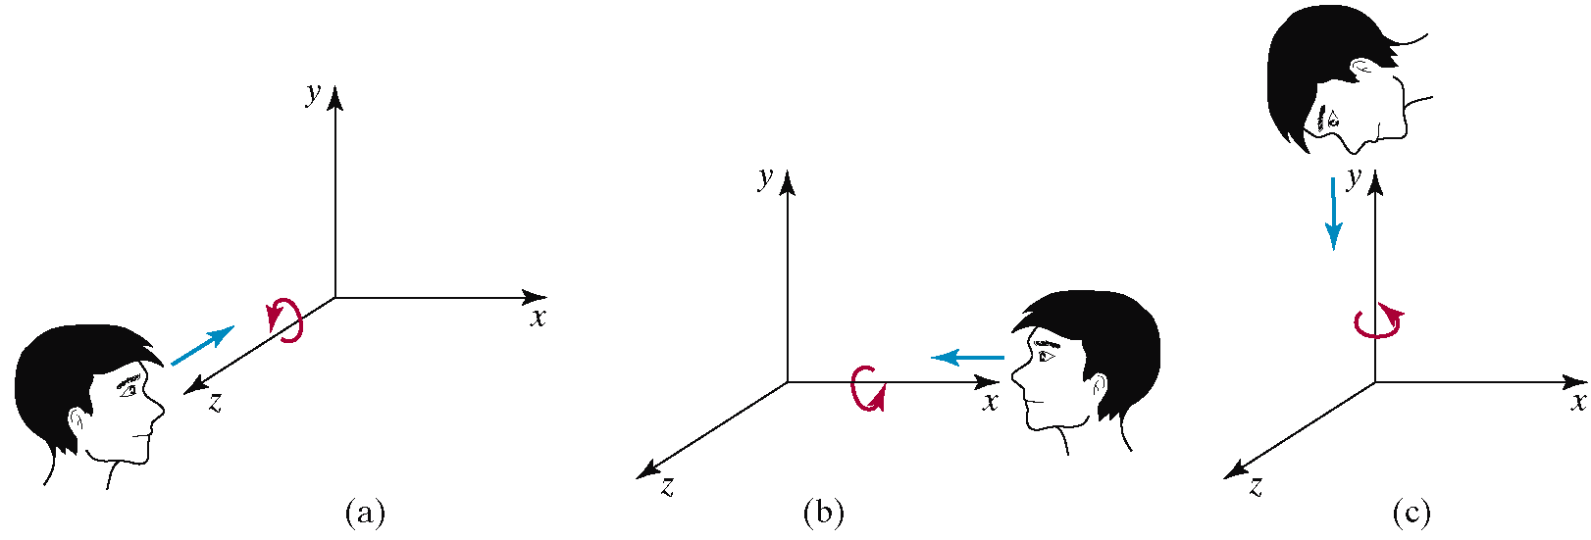
Examples of Affine Transformations
3D rotation

Slide 3
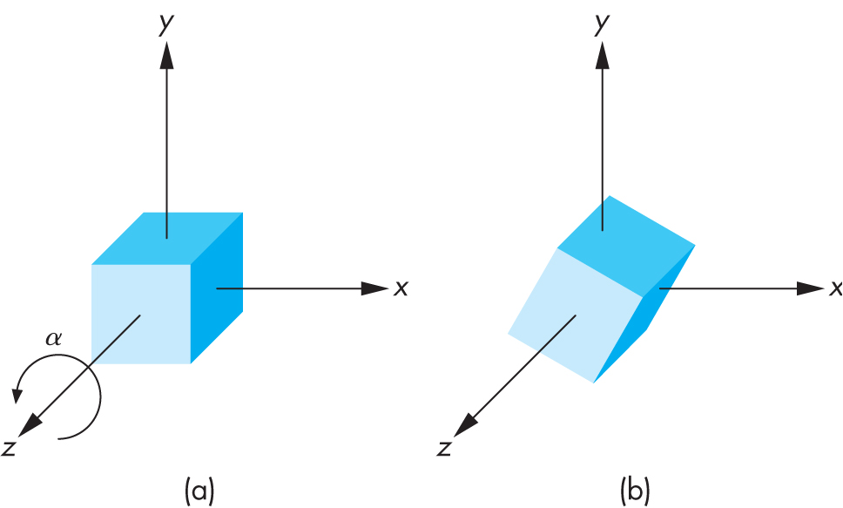
3D Rotation Matrix about Z Axis
R = R_{z}(θ) =

Slide 4
3D Rotation about x and y axes
Same argument as for rotation about z axis
For rotation about x axis, x is unchanged
For rotation about y axis, y is unchanged
R = R_{x}(θ) =
R = R_{y}(θ) =

Slide 5
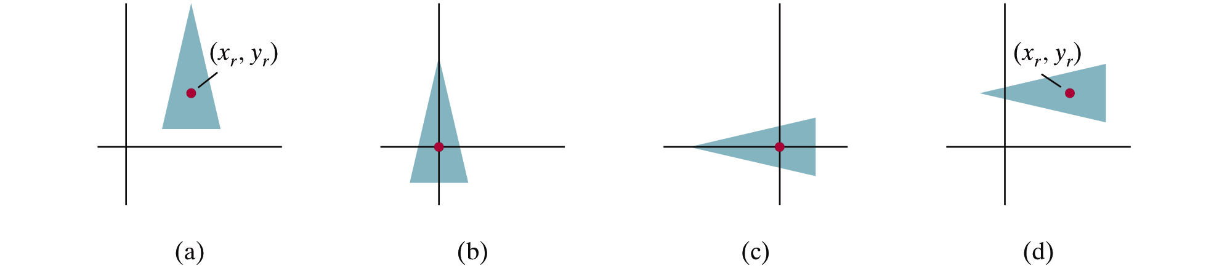
2D Pivot-Point Rotation
Rotation with respect to a pivot point (x,y)

Slide 6
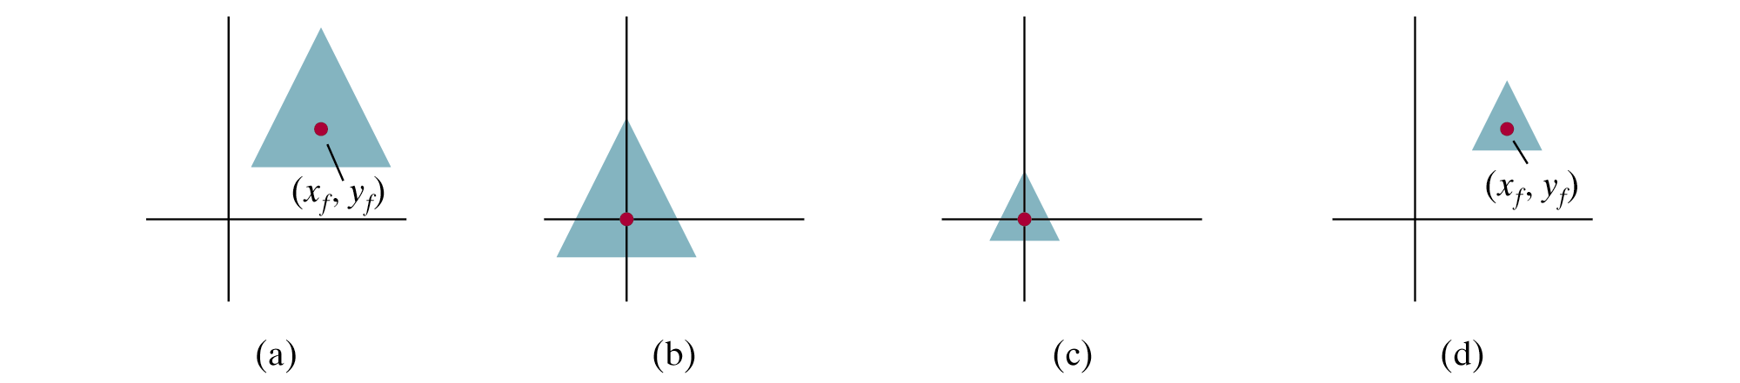
2D Fixed-Point Scaling
Scaling with respect to a fixed point (x,y)

Slide 7
Scaling Direction
Scaling along an arbitrary axis

Slide 8
Properties of Affine Transformations
Any affine transformation between 3D spaces can be represented as a combination of a linear transformation followed by translation
An affine transf. maps lines to lines
An affine transf. maps parallel lines to parallel lines
An affine transf. preserves ratios of distance along a line
An affine transf. does not preserve absolute distances and angles

Slide 9
Rigid Transformations
A rigid transformation T is a mapping between affine spaces
T maps vectors to vectors, and points to points
T preserves distances between all points
T preserves cross product for all vectors (to avoid reflection)
In 3-spaces, T can be represented as

Slide 10
Rigid Body Rotation
Rigid body transformations allow only rotation and translation
Rotation matrices form SO(3)
Special orthogonal group
(Distance preserving)
(No reflection)

Slide 11
Rigid Body Rotation
R is normalized
The squares of the elements in any row or column sum to 1
R is orthogonal
The dot product of any pair of rows or any pair columns is 0
The rows (columns) of R correspond to the vectors of the principle axes of the rotated coordinate frame

Slide 12
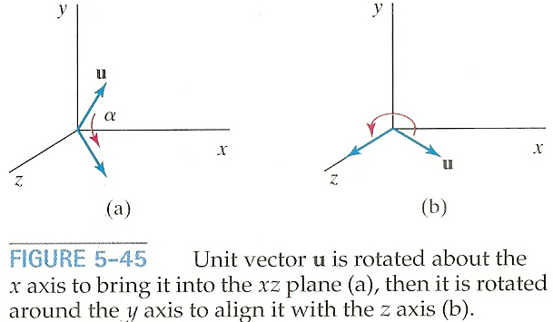
3D Rotation About Arbitrary Axis
How to rotate around u vector (u = given rotation axis)
➔ Rotate about x and y axes to make u align with the z-axis

Slide 13
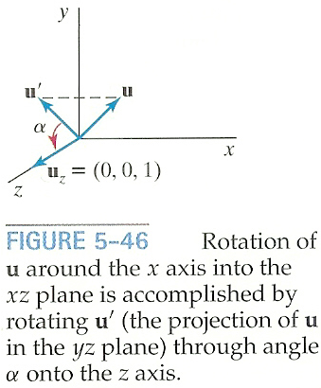
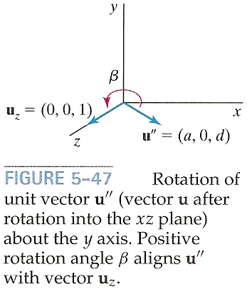
3D Rotation About Arbitrary Axis
Rotate u onto the z-axis
u’: Project u onto the yz-plane to compute angle α
u’’: Rotate u about the x-axis by angle α
Rotate u’’ onto the z-asis

Slide 14
3D Rotation About Arbitrary Axis
Rotate u’ about the x-axis onto the z-axis
Let u=(a,b,c) and thus u’=(0,b,c)
Let uz=(0,0,1)

Slide 15
3D Rotation About Arbitrary Axis
Rotate u’ about the x-axis onto the z-axis
Since we know both cos α and sin α, the rotation matrix can be obtained
Or, we can compute the signed angle α
Do not use acos() since its domain is limited to [-1,1]

Slide 16
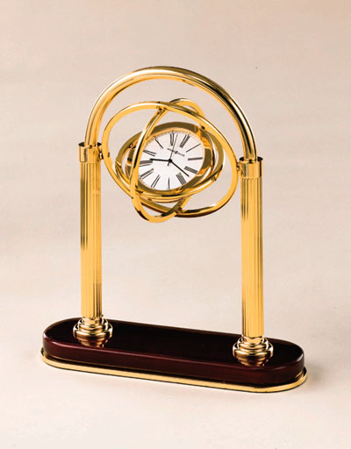
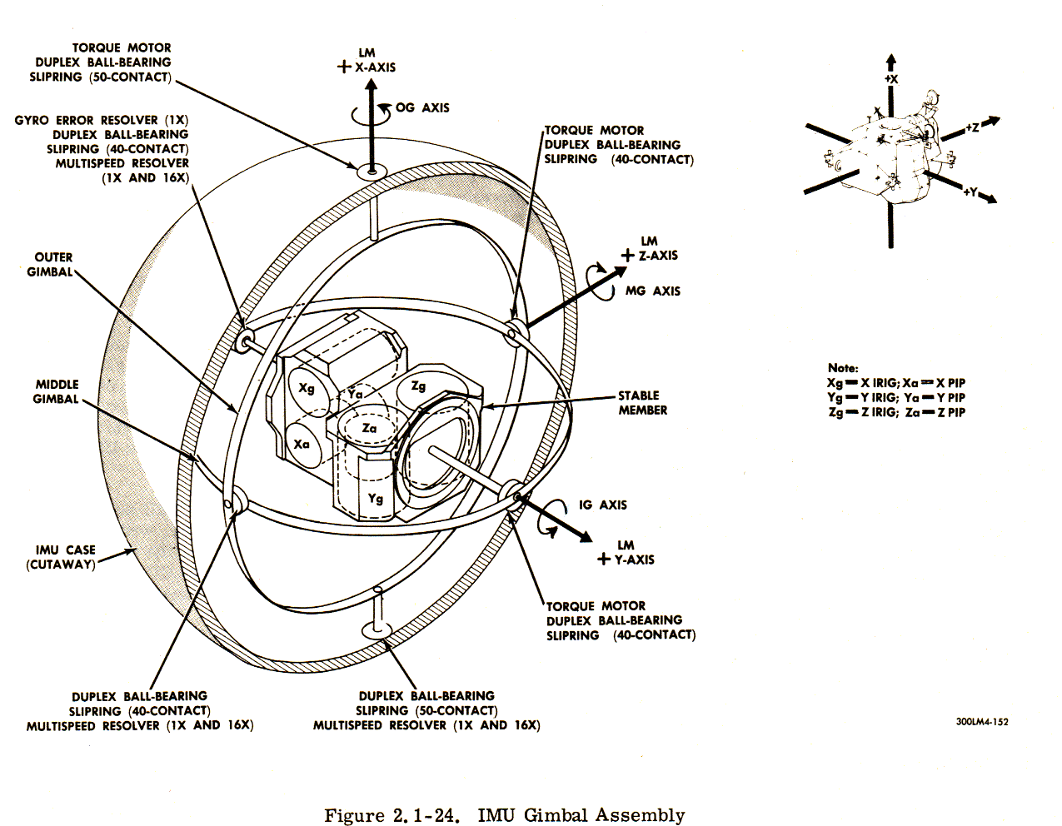
Gimble
Hardware implementation of Euler angles
Aircraft, Camera

Slide 17
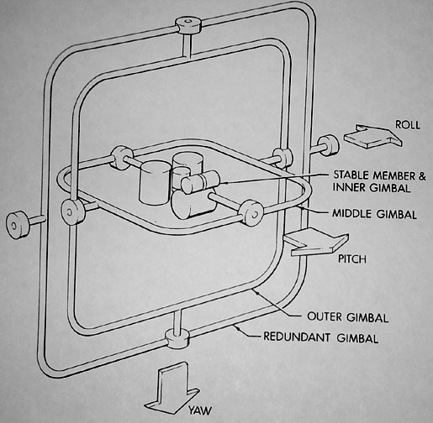
Euler Angles
Rotation about three orthogonal axes
12 combinations
XYZ, XYX, XZY, XZX
YZX, YZY, YXZ, YXY
ZXY, ZXZ, ZYX, ZYZ
Gimble lock
Coincidence of inner most and outmost gimbles’ rotation axes
Loss of degree of freedom

Slide 18
Euler angles
Arbitrary rotation can be represented by three rotation along x,y,z axis

Slide 19
Euler Angles
Euler angles are ambiguous
Two different Euler angles can represent the same orientation
This ambiguity brings unexpected results of animation where frames are generated by interpolation.

Slide 20
Smooth Rotation
Create transformations from M₀ to M_{n} smoothly
Problem: find a sequence of model-view matrices M₀,M₁,…..,M_{n} for each frame to see a smooth transition
One solution for rotation (using Euler angles):
Find R₀= R_{0z} R_{0y} R_{0x} and R_{n}= R_{nz} R_{ny} R_{nx}
Then, Create a sequence of rotation R₀,R₁,…..,R_{n} : R_{i}= R_{iz} R_{iy} R_{ix} (where, ix, iy, iz is the interpolated angles from the beginning and the end)
Not very effective!
Quaternions can do it better!

Slide 21
Quaternions
Extension of imaginary numbers from two to three dimensions
Requires one real and three imaginary components i, j, k
Quaternions can express rotations on sphere smoothly and efficiently. Process:
Model-view matrix → quaternion
Carry out operations with quaternions
Quaternion → Model-view matrix
q=q₀+q₁i+q₂j+q₃k
Computer Animation 수업에서 다룹니다.

Slide 22
Taxonomy of Transformations
Rigid
Affine
Projective

Slide 23
Composite Transformations
Composite 2D Translation

Slide 24
Composite Transformations
Composite 2D Scaling

Slide 25
Composite Transformations
Composite 2D Rotation

Slide 26
OpenGL Geometric Transformations

Slide 27
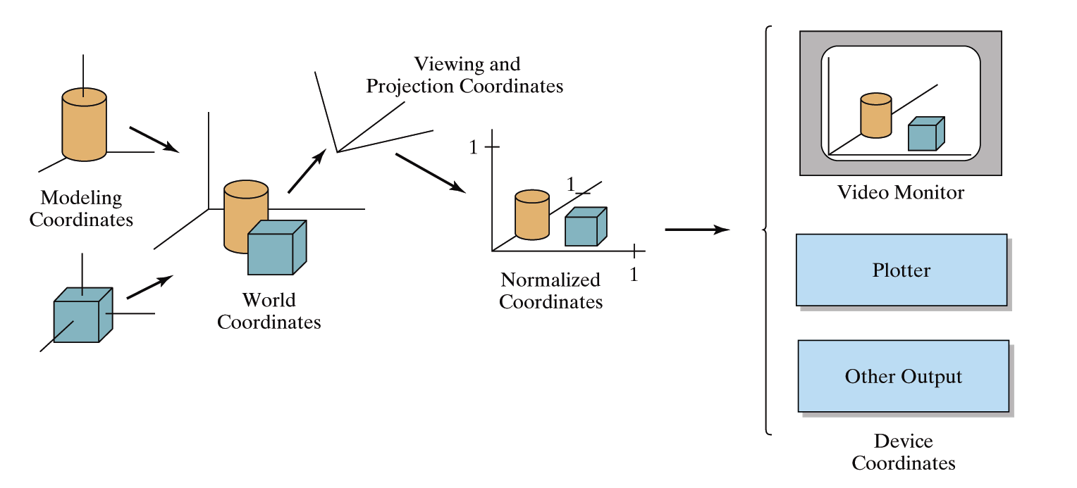
OpenGL Geometric Transformations
Consecutive Transformations in OpenGL Pipeline
Model Transform
: local to world
View Transform
: world to camera
Projection Transform
: camera to screen

Slide 28
OLD OpenGL Matrices
Two types of predefined transformations (matrices)
Model-View (GL_MODELVIEW) : model+view
Projection (GL_PROJECTION)
Single set of functions for manipulation
Select which to manipulated by
glMatrixMode(GL_MODELVIEW);
glMatrixMode(GL_PROJECTION);

Slide 29
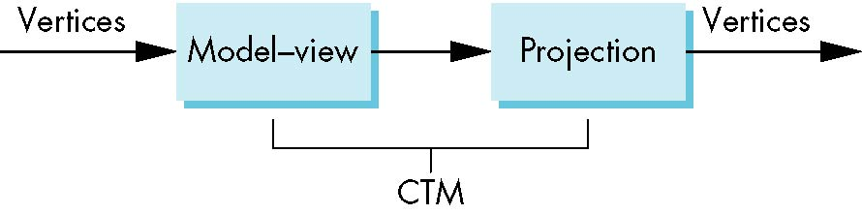
Current Transform Matrix (CTM) in OLD OpenGL
OpenGL had a model-view and a projection matrix in the pipeline which were concatenated together to form the CTM
We will emulate this process
CTM: Current Transform Matrix

Slide 30
OLD OpenGL Geometric Transformations
Basic Transpormation:
glLoadIdentity();
glTranslatef(tx, ty, tz);
glRotatef(theta, vx, vy, vz); angle-axis
(vx, vy, vz) is automatically normalized
glScalef(sx, sy, sz);
glLoadMatrixf(Glfloat elems[16]);
Multiplication
glMultMatrixf(Glfloat elems[16]);
The current matrix is postmultiplied by the matrix
Column major

Slide 31
Model Transformation

Slide 32
연습: 바람개비(풍차)만들기

Slide 33
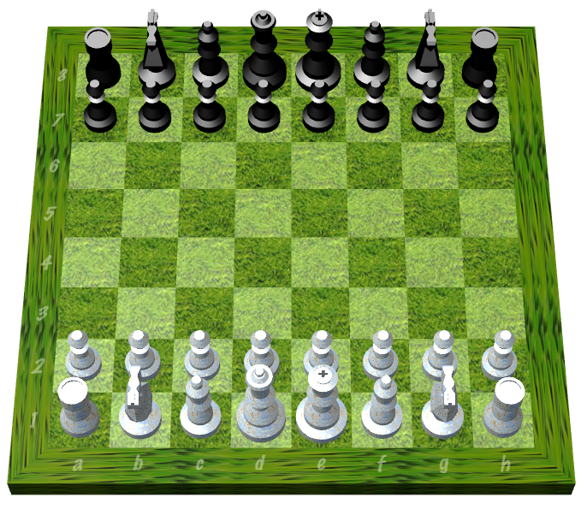
Instance Transformation
Often we need several instances of an object
Wheels of a car
Arms or legs of a figure
Chess pieces

Slide 34
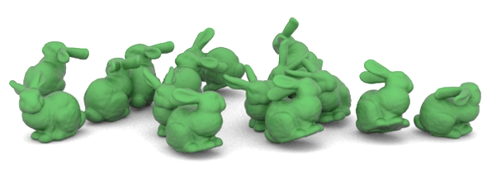
Instance Transformation
Instances can be shared across space or time
Write a function that renders the object in “standard” configuration
Apply transformations to different instances
Typical order: scaling → rotation → translation

Slide 35
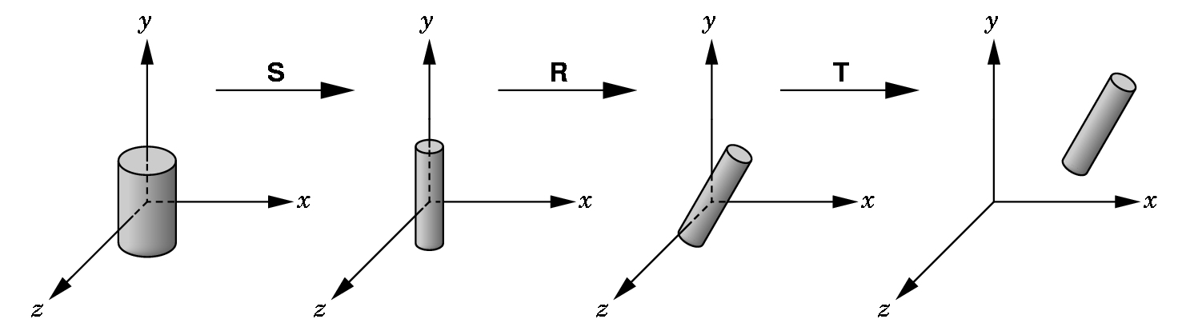
Sample Instance Transformation (old style)
glMatrixMode(GL_MODELVIEW);
glLoadIdentity();
glTranslatef(...);
glRotatef(...);
glScalef(...);
gluCylinder(...);

Slide 36
구체적인 계획
0.8
y
y
0.25
x
1
z
0.5
0.4

Slide 37
Instance Transformation
Instances can be shared across space or time
Write a function that renders the object in “standard” configuration
Apply transformations to different instances
Typical order: scaling → rotation → translation

Slide 38
구체적인 계획
0.8
y
y
0.25
x
1
z
0.5
0.4

Slide 39
로보트 팔 만들기

Slide 40
로보트 팔 만들기2

Slide 41
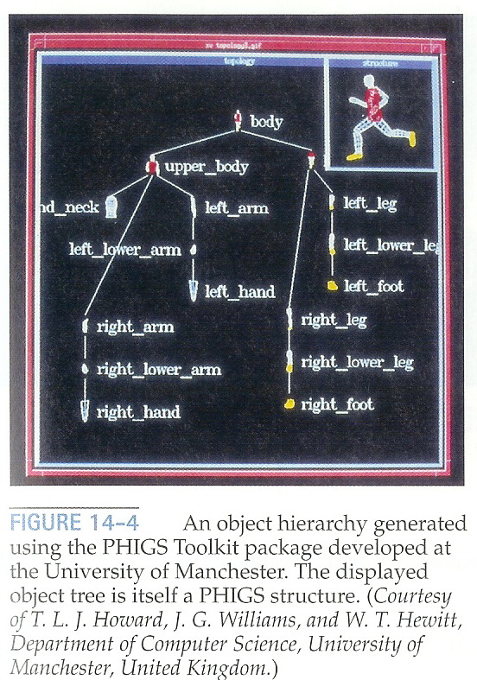
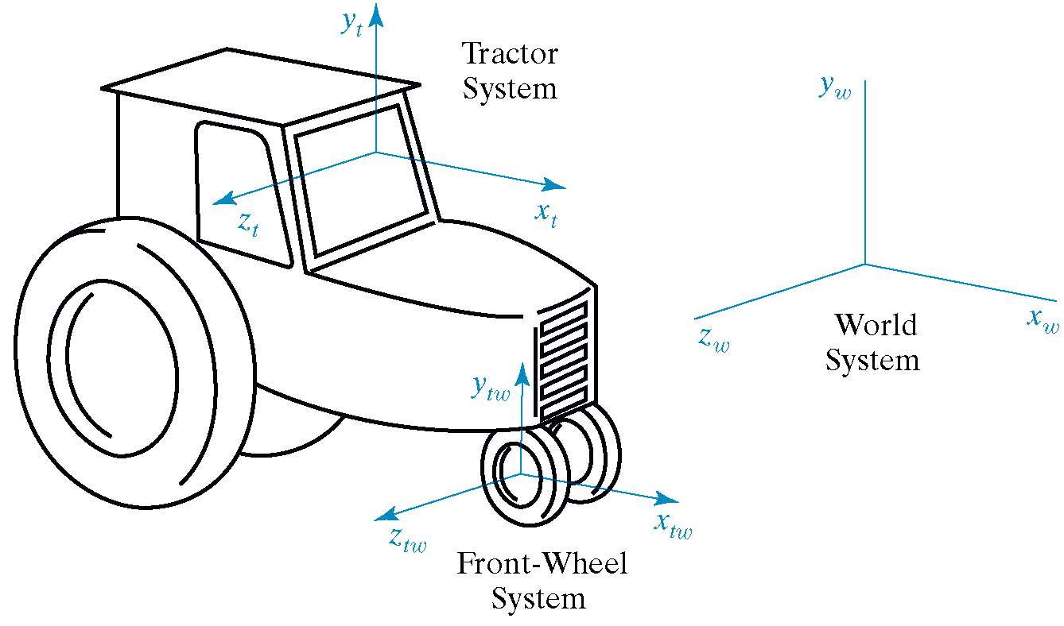
Hierarchical Modeling
A hierarchical model is created by nesting the descriptions of subparts into one another to form a tree organization

Slide 42
OpenGL Matrix Stacks (OLD)
Stack processing
The top of the stack is the “current” matrix
glPushMatrix(); // Duplicate the current matrix at the top
glPopMatrix(); // Remove the matrix at the top

Slide 43
Matrix Stacks by your own
We emulate Matrix Stacks by using:
Linked List such as std::list or std::deque
Or a tree structure for more generality.

